Slide 1
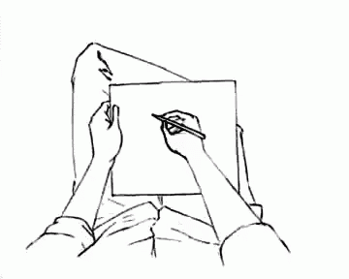
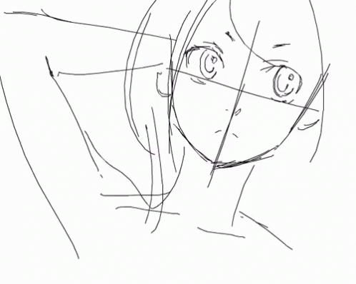
Art bible
Anna Metreveli

Slide 2
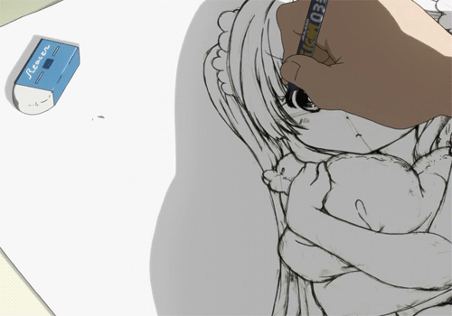
Conntents:
What is an Art Bible?
Why is it important?
What does it consist of?
Examples
Why is it useful?
How to make one: TODOs
Documentation/Links

Slide 3
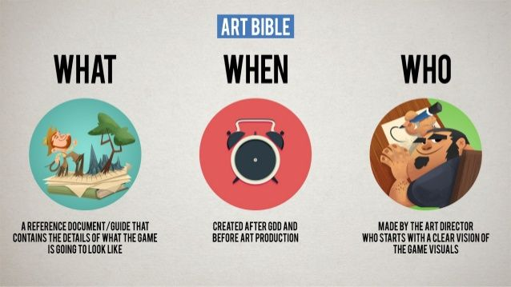
What is an art bible?
“Style Guide”, a document that contains color palettes, the style, the interface, the process of creating the asset. A document that explains the visuals and how they will be produced.
It usually begins with an introduction page where in a paragraph you summarize the style of art, the proportion of characters, the scenarios …

Slide 4
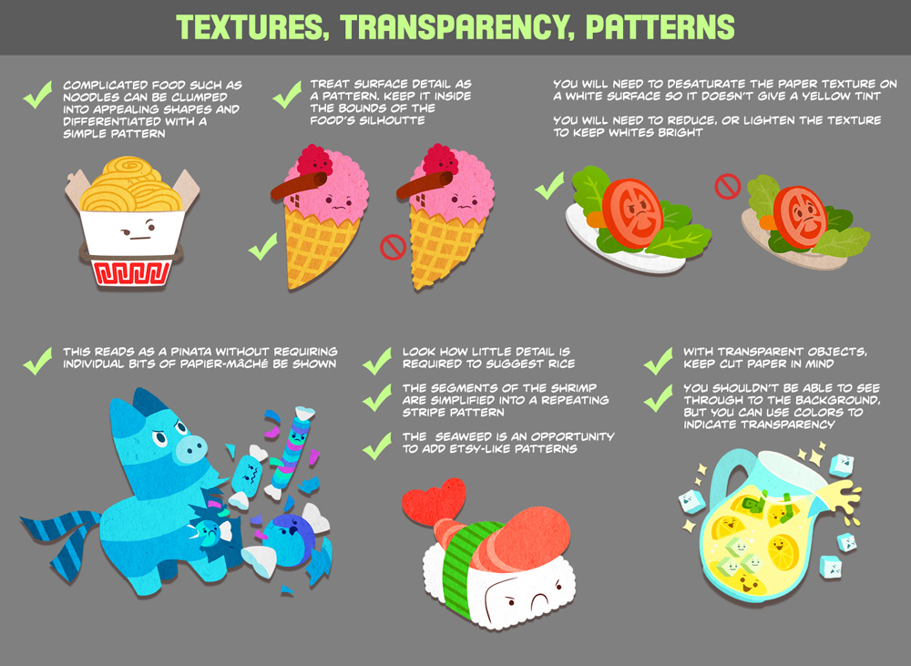

Slide 5
why is it important?
A useful tool for communicating the game’s vision.
“It helps the artistic vision to be carried all the way through to the final assets that appear in game.”
“The artists can work and rework assets on paper, when the cost is much lower, and then only create the actual assets when everyone agrees on what will appear in the game. “
“Outsourcing art assets will become more common as the volume of assets needed for next-generation titles increases, so clearly defined concept art ensures that the assets look consistent with the game, no matter where they are created.”
Notes:
Andrew Gahan in the book “3DS max Modeling for Games – Volume I”

Slide 6
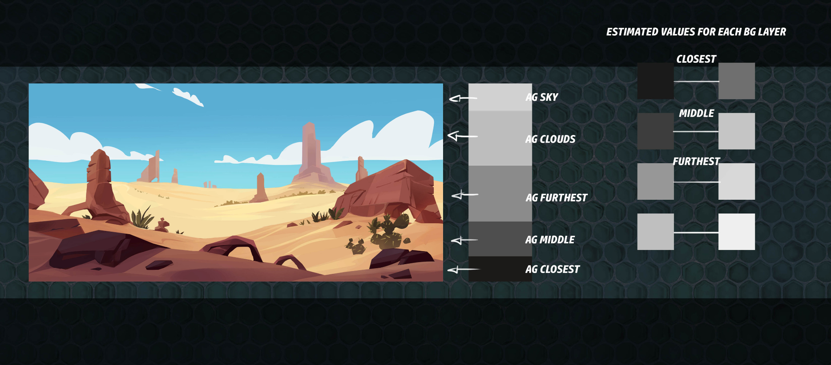

Slide 7
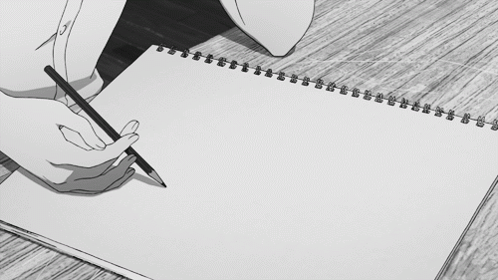
What does it consist of?
Art style
Character art
Atmosphere/Environment
Effects
Color palette
Camera
Texture and surface
User interface
Technical guidelines
Lighting
References
Notes:
If we follow the suggested contents that Telang (2013) talks about include:

Slide 8
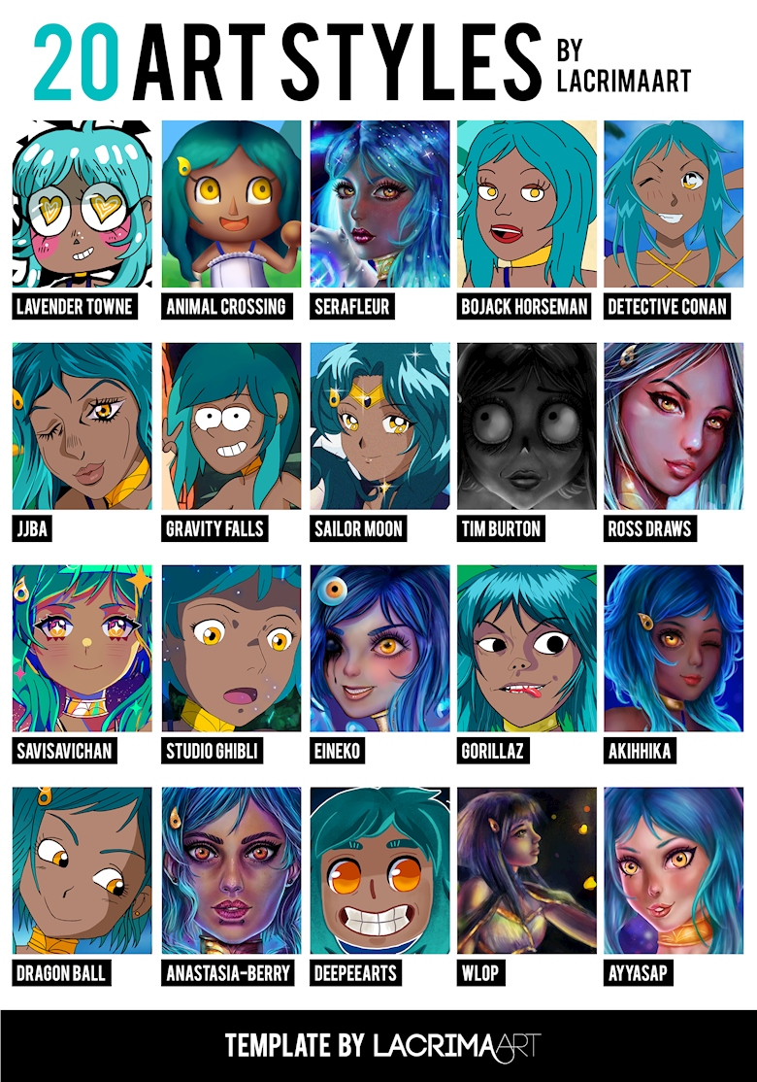
Art style
What aesthetic?

Slide 9
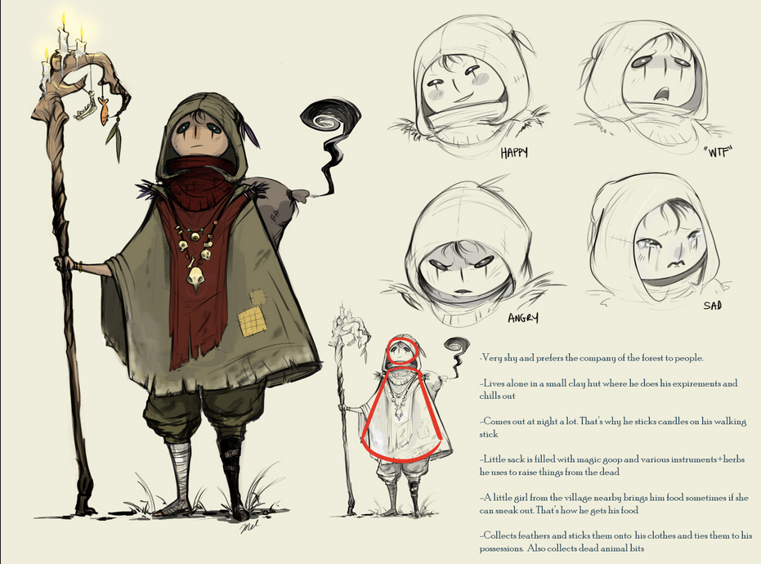
Character art
Define the basics to create a character

Slide 10
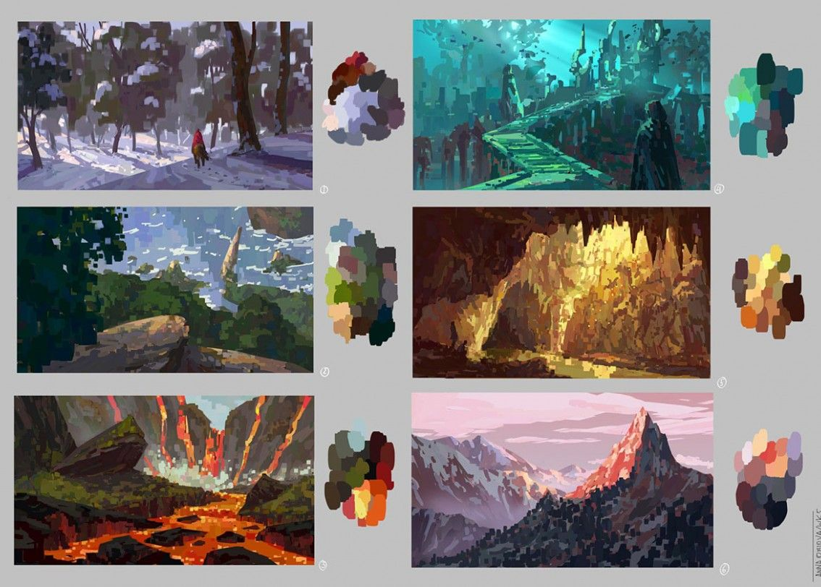
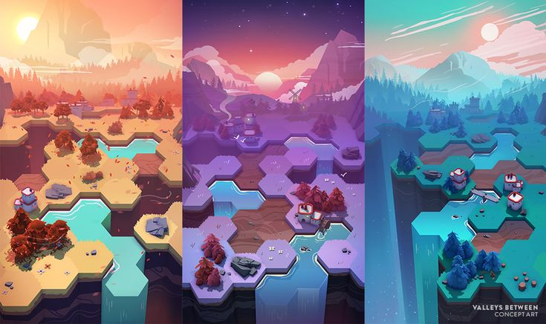
Atmosphere / Environment
Define the climate of your world

Slide 11
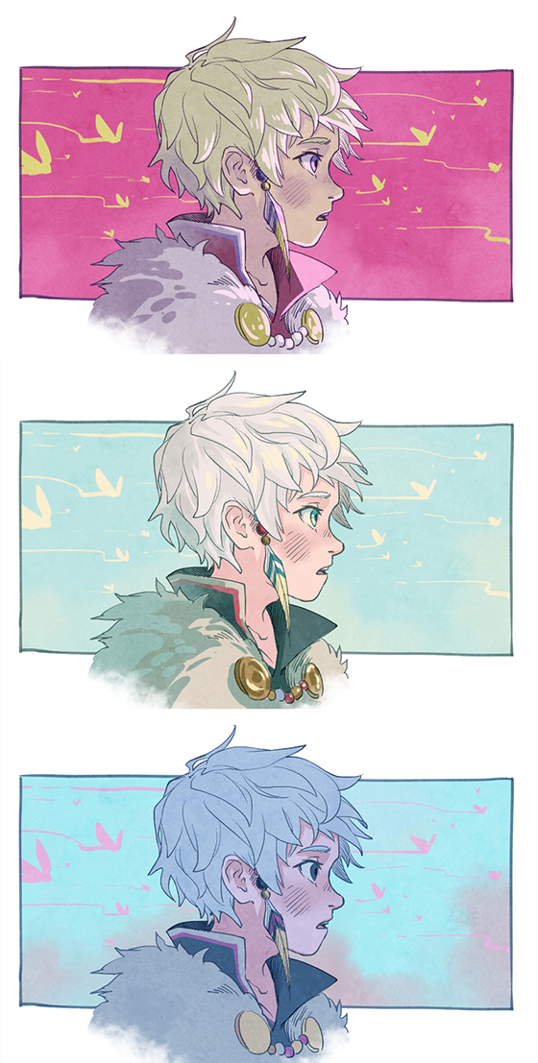
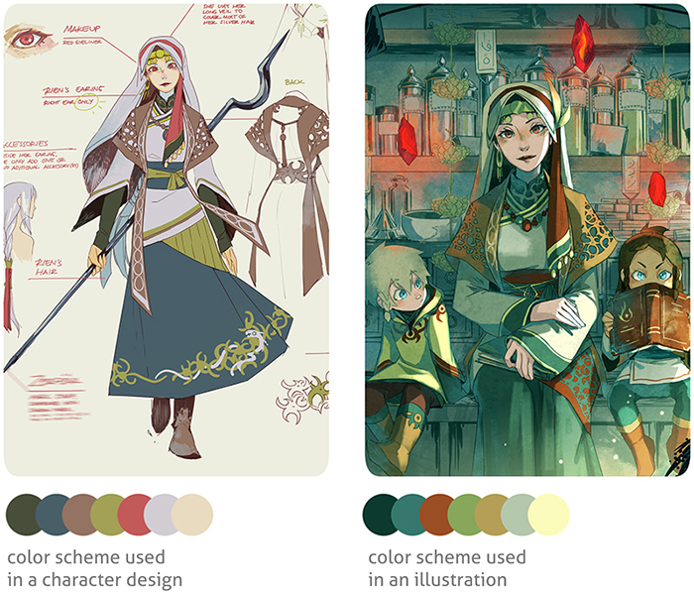
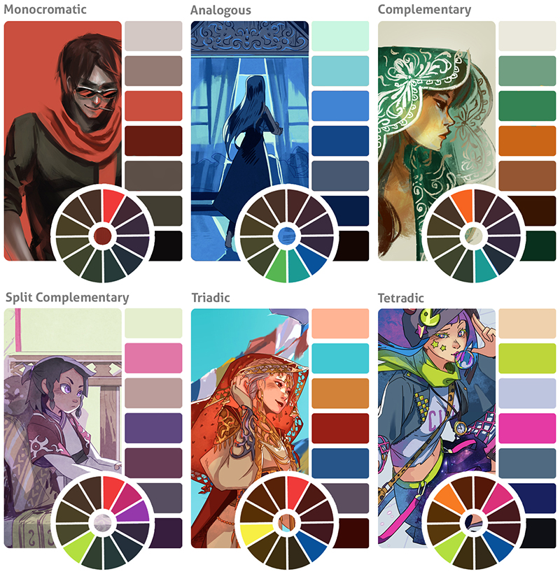
Colour Palette.
It is important that all colors maintain a relationship between them.
For this it is convenient to work on a color palette.

Slide 12
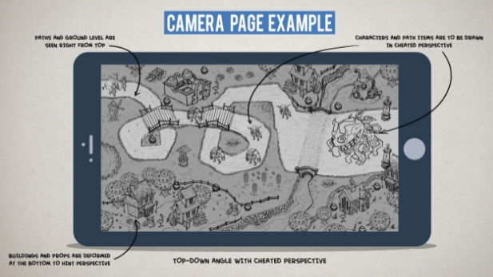
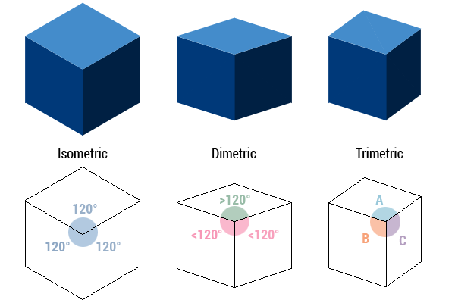
camera
In a narrative or strategy environment a static camera can help to accompany the story while in an action game the camera animations improve the immersion. We will decide: Position of the camera, Where is the horizon, Transitions, Effects, Camera changes in narrative …

Slide 13
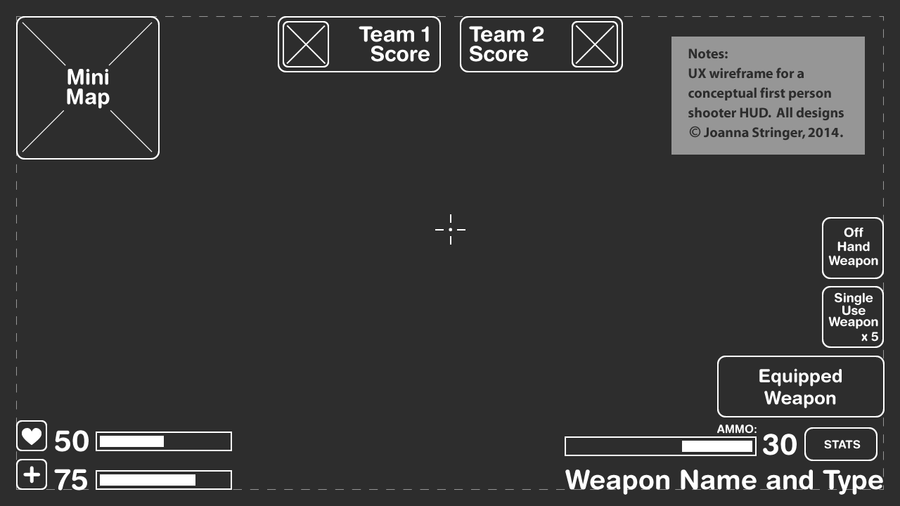
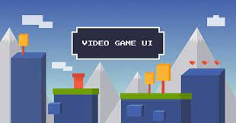
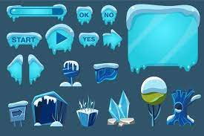
User interface.
UI has to be understandable to the user without saturating it. New players may struggle and find it confusing otherwise. It is convenient to use the UI with knowledge and with an aspect that enhances immersion. At this point look for references or sketch possible aspects of the UI, such as menus, buttons, etc…

Slide 14
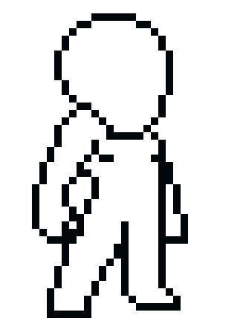
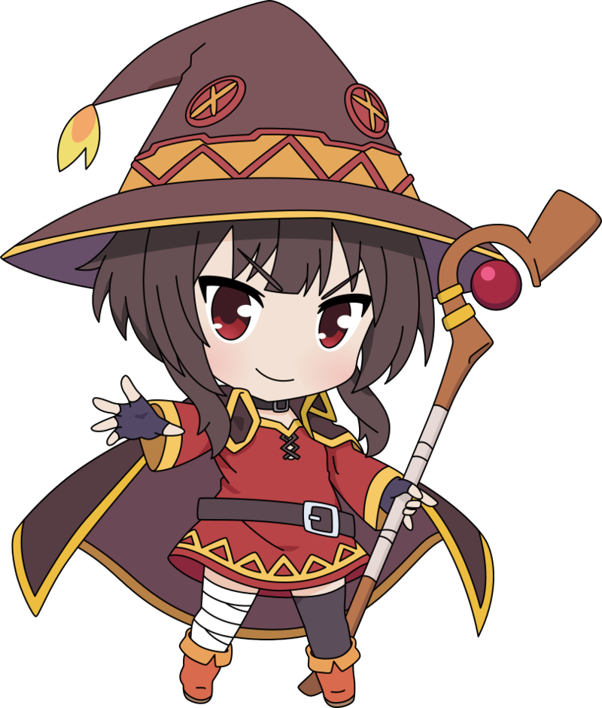

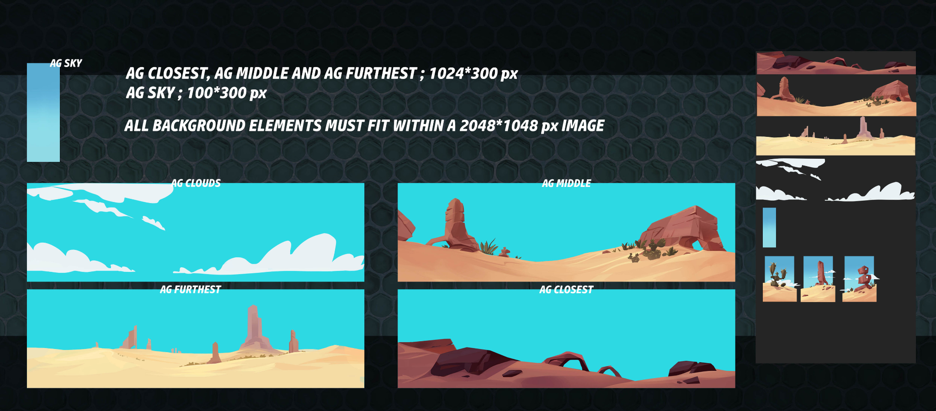
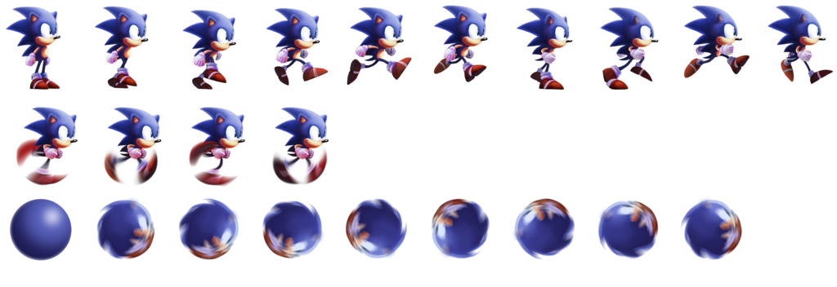
Technical guidelines
Here the work methodology is decided. How the images will be exported, in what format, in what composition, what programs will be used…

Slide 15
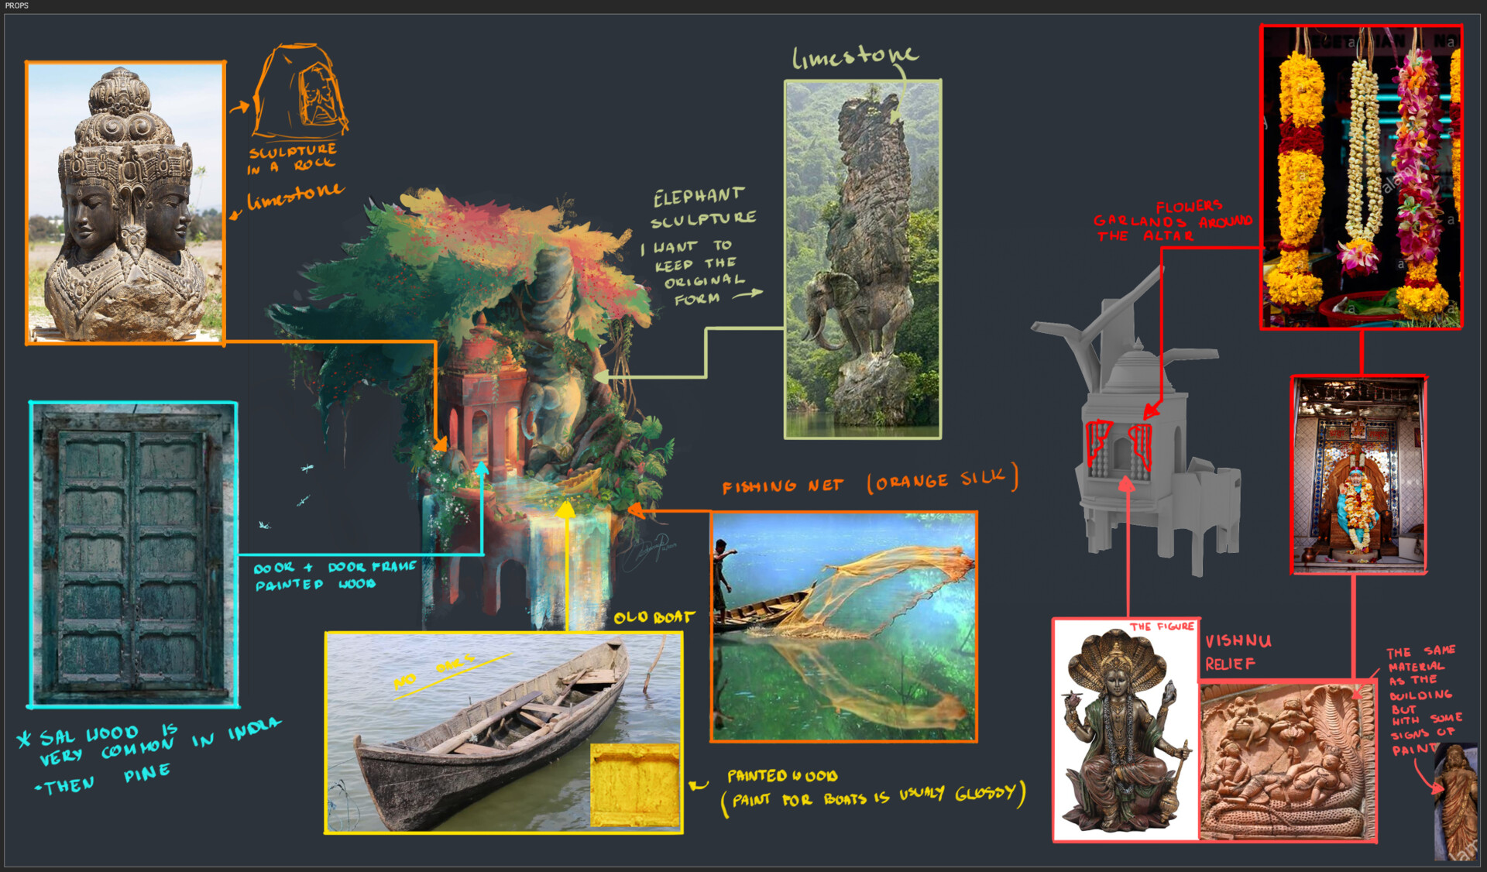
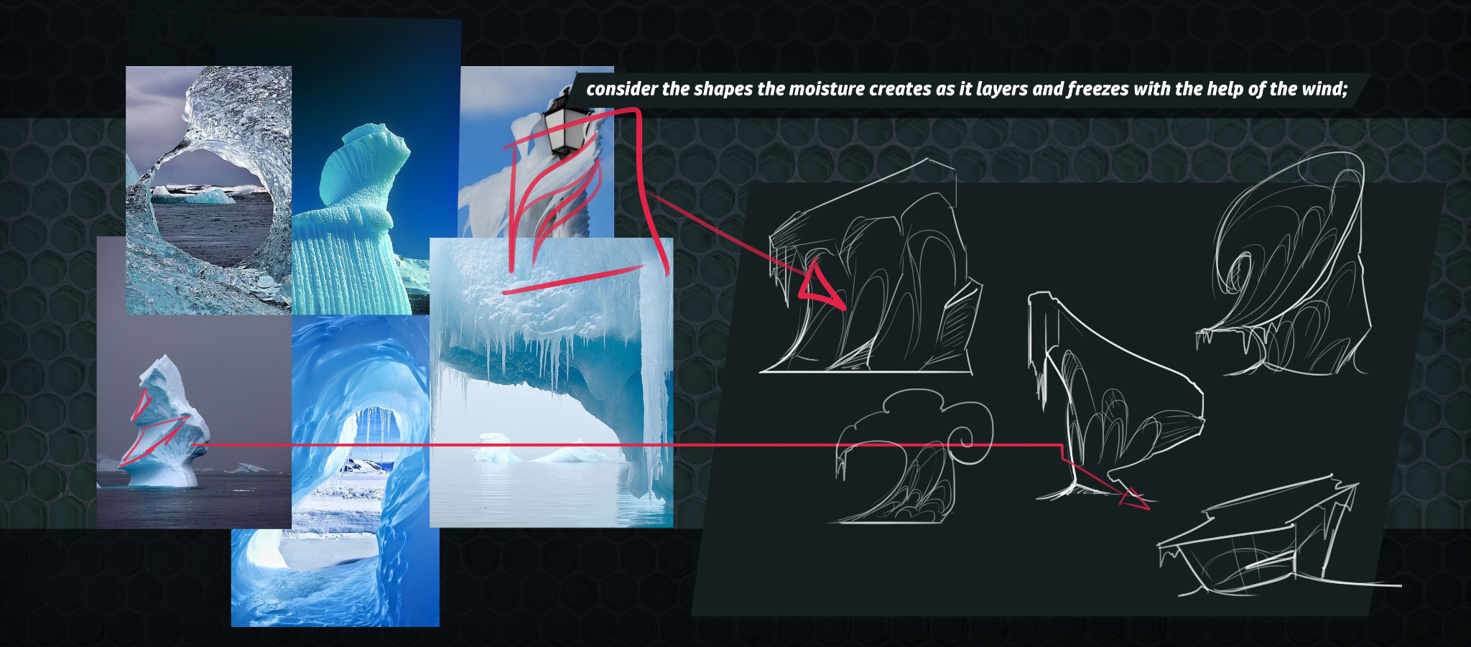
references
What aesthetics will the whole game be in, what kind of ambient will be held throughout the game?

Slide 16
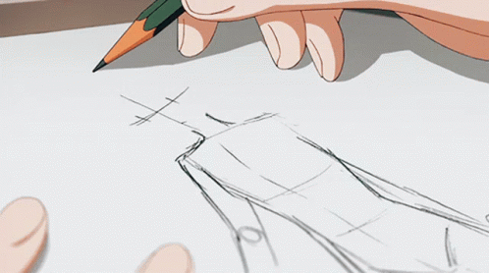
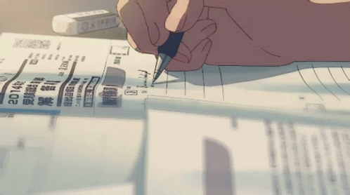
Why is it useful?
Talks about how the game will look
Maintains consistency during development
Helps the art team understand the direction of art
Explains how and why stylistic decisions are made
Helps new members who join
Helps in marketing

Slide 17
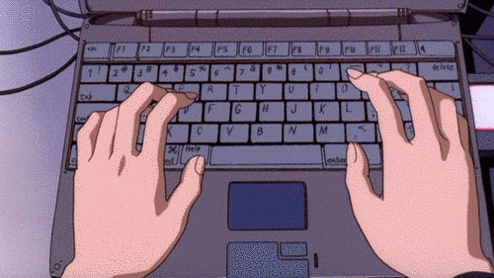
How to make an art bible?
Who makes it? - Art Director
When should it be done? - After GDD, before production.

Slide 18
Todo 1.
Create a moodboard. Answer the following questions:
Who is the target audience?
Which esthetic?
Where?
When?

Slide 19
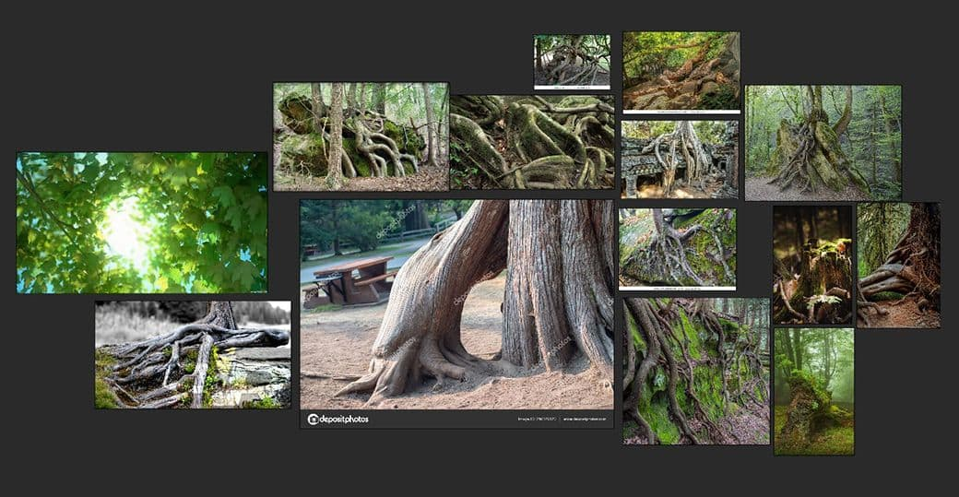

Slide 20
todo 2.
Decide how many and which characters you need, research for references to base them on.
How detailed?
Which is the general way of doing their proportions/faces?
Which details will be important/ stand out?
Start thumbnailing

Slide 21
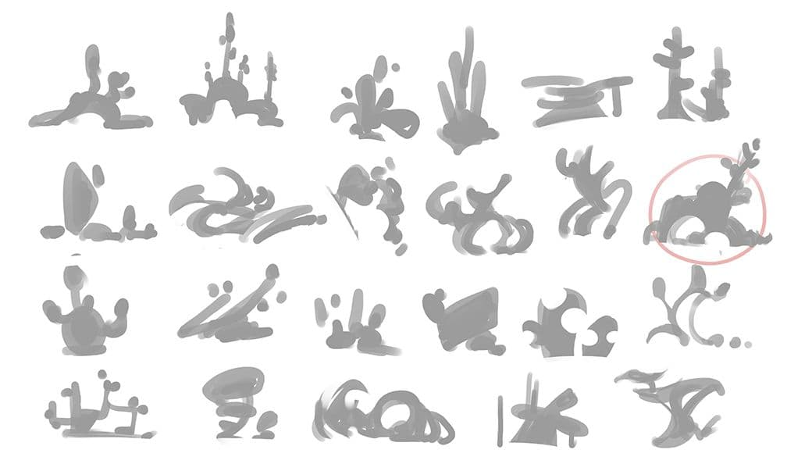
Notes:
Silhouettes are a very quick and intuitive way of designing. They allow me to see the overall shape, as the form of an object describes the “personality” of an item. Roundness will make an object feel friendly, while sharp angles carry connotations of aggression. I quickly settled with bold, round shapes. I wanted my world to feel big and voluminous, but not scary.

Slide 22
Todo 3.
Next settle on an artistic direction:
Try out three-six different styles, all with varying colouring, lining and shading techniques.
You can also alter the shape of the props to match the feel of each style.

Slide 23
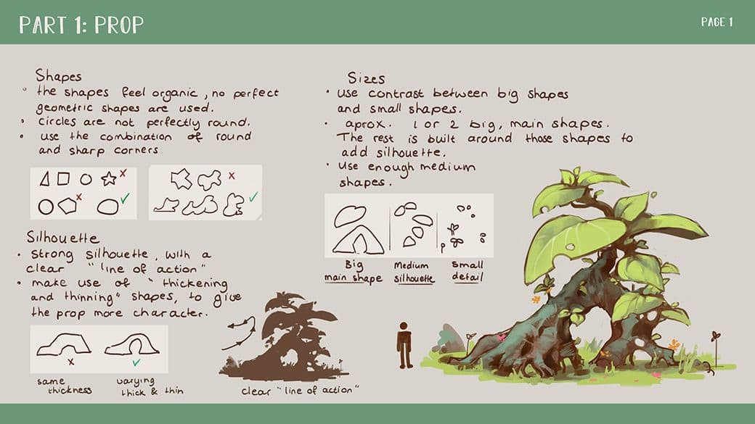

Slide 24
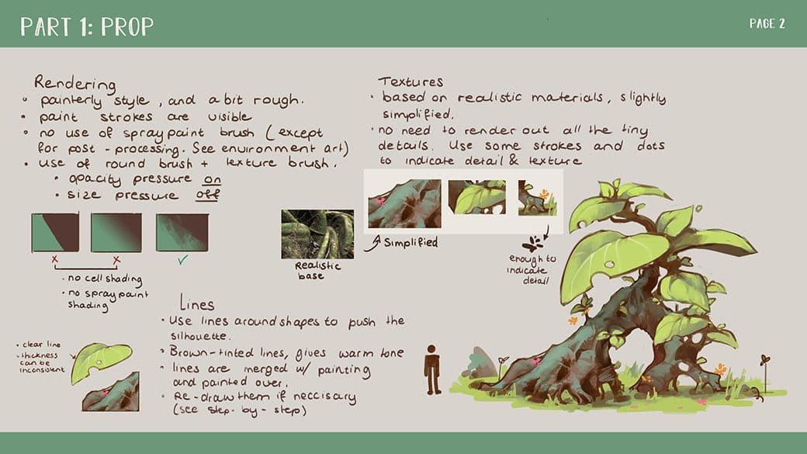

Slide 25
todo 4.
Choose a colour palette you will use throughout.
You can use the following websites to help you:
Adobe Color:
https://color.adobe.com/es/create/color-wheel/
Colour Hex:
https://www.color-hex.com/color-palettes/popular.php

Slide 26
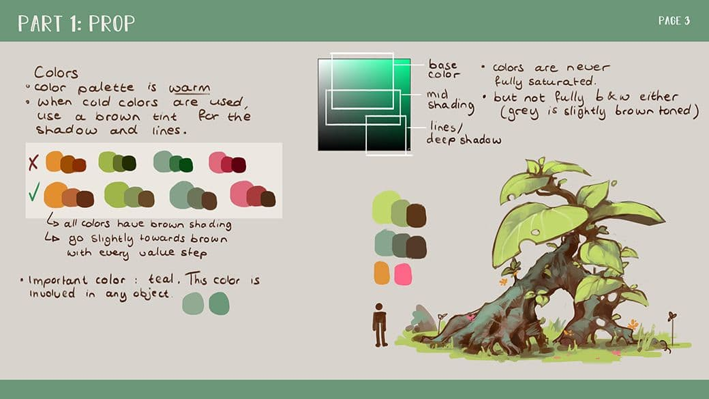

Slide 27
todo 5:
Work on developing more details in characters.
After deciding on the definitive direction, make a couple of alternate versions, just to see how overall it looks.
Do you need to change the proportions or try some different faces or such?
Any minor tweaks?

Slide 28
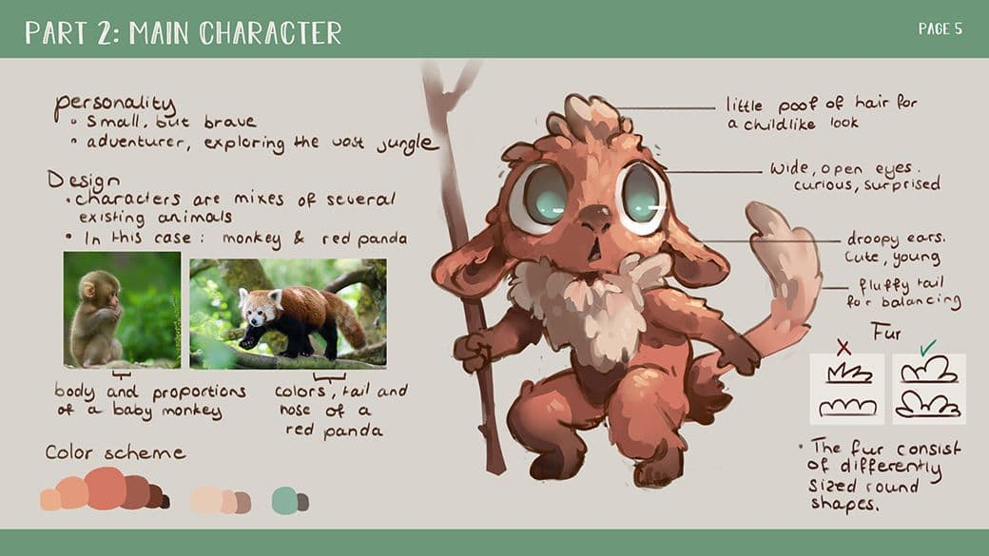

Slide 29
todo 6.
Making a sheet with a bunch of different expressions really helps understand the character on a deeper level, because defining a character’s personality changes the way they interact with their environment.
Try different poses/ movement for animation.

Slide 30
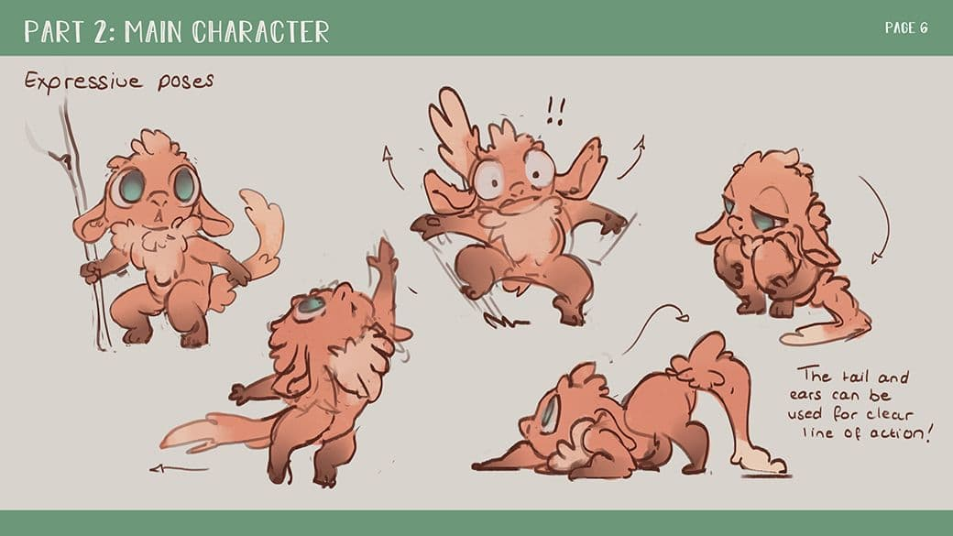

Slide 31
Todo 7.
The final part of the project: the one where all work sticks together.
Aim for all design elements to harmonise.
Every prop and shape in the painting leads to the feeling or atmosphere you are trying to convey.

Slide 32
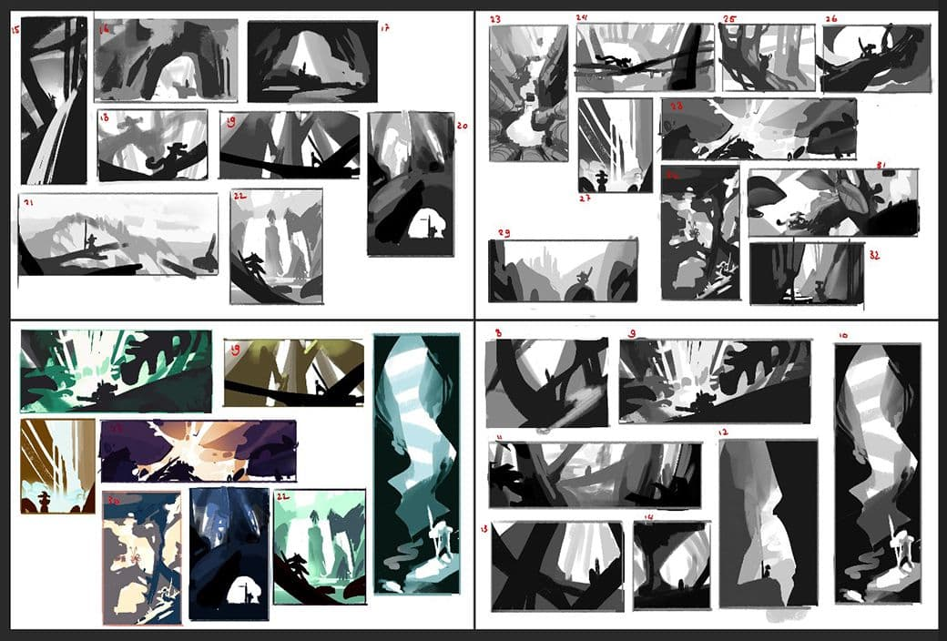

Slide 33
Links
What is an art bible?:
https://dusthandler.github.io/Art_Bible/
Art bible for video game:
https://www.hdm-stuttgart.de/stage/mediafiles/3324/sonstiges/WholeHoleArtBible.pdf
Example of environment art bible:
https://www.artstation.com/artwork/nAYke
Colour in games:
https://www.gamedeveloper.com/design/color-in-games-an-in-depth-look-at-one-of-game-design-s-most-useful-tools

Slide 34
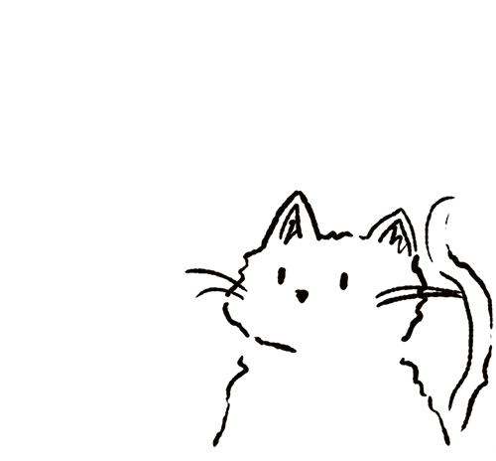
Thank you for your attention!

